Slide 1

C# programming 101
SOLID design principles make test-driven development (TDD)
Abraham Lock
MPE MIT

Slide 2
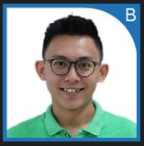
Biography – Abraham Lock [PG] (11.5 years)
TMG SCDS SWE
(2011- 2015)
Joined as RCG 2011- 2015
DEG MVS SWE
(2015-2017)
Debug team on Fusion.
TMG SCDS SWE
(2017 – 2020)
Lead Developer + architecture for a new software framework on Intel Factory Solver.
Software Developer using C# & SQL
Developing Intel Factory Solver for Industry Engineers & Planners
Developer on Legacy tools
Owner of Test Program Manager Tool (PPV) for IACPU product
DEG MIT SWE
(2020 – Till now)
Developer on Aqua V4 with POC HBase.
Software Architect + Lead Developer + Product Owner for Aqua V4 in MPE.
Lambda architecture database (Hot, Warm, Cold storage), Pub-Sub architecture & big data processing for the team factory planning
Hand on Database Architecture Design, Service, Pub-Sub & UI development.
Recently moved to Lynx project.
Production support.
Production support.
TMG SCDS SWE
(2011- 2015)
Surviving & learning State
DEG MVS SWE
(2015-2017)
Get Married on 2016
TMG SCDS SWE
(2017 – 2020)
Blessed with first born baby girl
DEG MIT SWE
(2020 – Till now)
Blessed with a second-born baby boy. (No more & that all)

Slide 3
Agenda
GitHub Code Sample from Abraham
SOLID vs Non-SOLID
Simple Interactive Program
Non-SOLID vs SOLID code. (Code walkthrough session)
Explain the SOLID Design Principle
What is Test Driven Development (TDD)?
What is Unit Testing?
Explanation of 3 A’s [Arrange, Act, Assert]
The Benefits and Purpose of Unit Testing
SOLID + TDD Walkthrough
TDD without SOLID vs TDD with SOLID sample (Code walkthrough session)
NAME OF SESSION

Slide 4
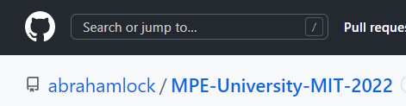
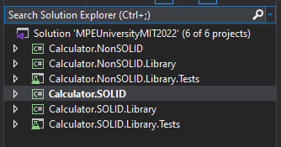
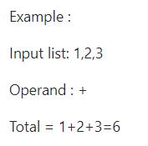
Lecture Code For This Lesson
GitHub : https://github.com/abrahamlock/MPE-University-MIT-2022
Simple examples with an interactive project.
Demonstrating (simple) use cases
of dependency injection
and how it can make code easier to test.

Slide 5
What is SOLID Design Principle?
The five principles are
1. Single Responsibility Principle 2. Open / Closed Principle 3. Liskov Substitution Principle 4. Interface Segregation Principle 5. Dependency Inversion Principle
SOLID is an acronym for five design principles that make code easier to understand, test, maintain, and more flexible. Robert C. Martin, one of the key authors of the Agile Manifesto is a big proponent of both TDD and SOLID design principles. The SOLID principles were first conceptualized by Robert C. Martin in his 2000 paper.
SOLID Overview

Slide 6
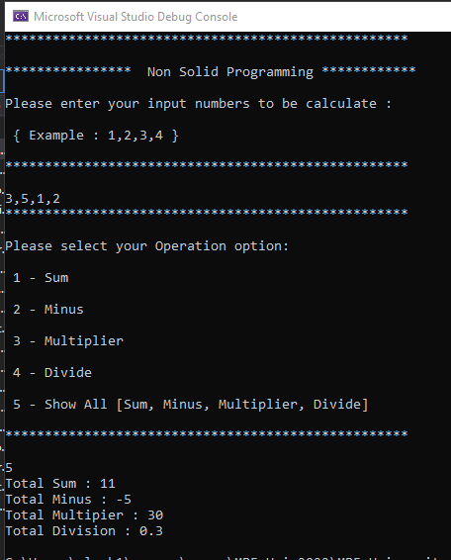
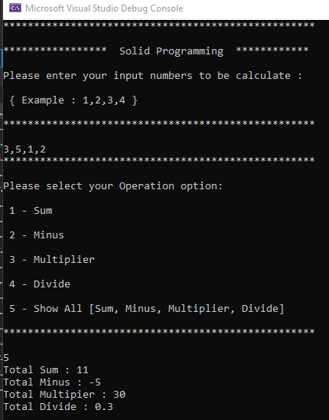
Simple Interactive Program
This simple program will
be based on the user enter
list of numbers +selected Operand. Then generate the total.
Example :
Input list: 1,2,3
Operand : +
Total = 1+2+3=6
VS
Simple Interactive Program

Slide 7
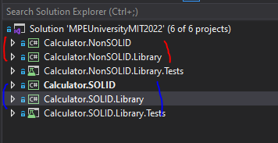
Showing SOLID vs NONSOLID Example
Code Walkthrough

Slide 8
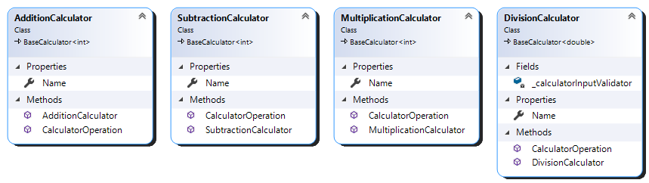
Single Responsibility Principle
This principle states:
-> A class should have only a single responsibility.
SOLID

Slide 9
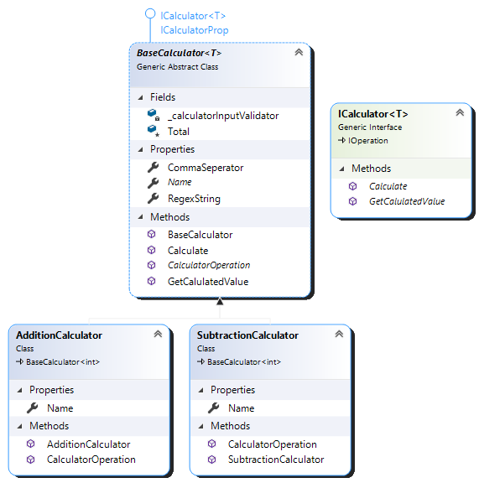
Open Closed Principle
This principle states:
-> Software entities should be open for extension
but closed for modification.
-> Be able to add new functionality without changing existing code.
SOLID

Slide 10
Liskov Substitution Principle
This principle states:
-> Objects in a program should be replaceable with instances of
their subtypes without altering the correctness of that program.
SOLID

Slide 11
Quiz What is O in the SOLID principle?
Open-Can Principle
Open-Closed Principle
Open-Cannot Principle
Open-Closure Principle

Slide 12
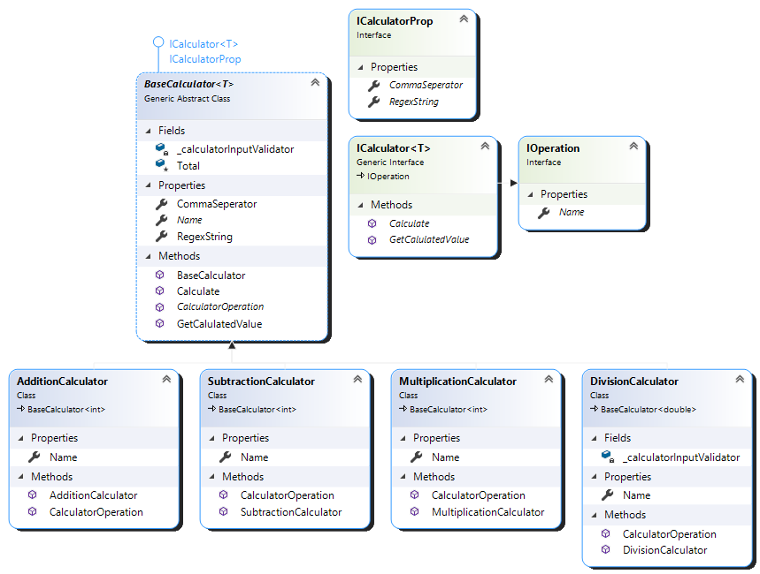
Interface Segregation Principle
This principle states:
-> Many client-specific interfaces are better
than one general-purpose interface
SOLID

Slide 13
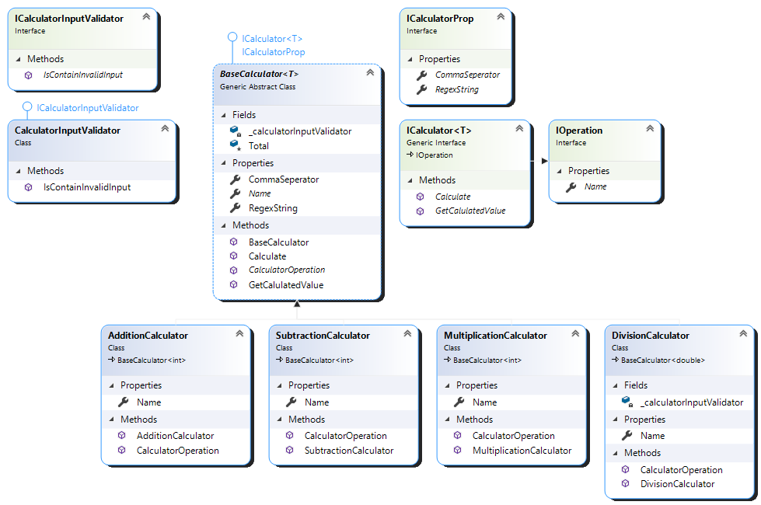
Dependency Injection Principle
This principle states:
-> High-level modules should not depend on
low-level modules.
Both should depend on abstractions.
-> Abstractions should not depend on details.
Details should depend on abstractions.
SOLID

Slide 14
Quiz What is D in the SOLID principle?
Dependency Inversion Principle
Dependency Inventor Principle
Dependency Insurance Principle
Dependency Injection Principle

Slide 15
What is TDD?
Test Driven Development consists of programming unit tests for the core functionalities of an application before creating classes, projects, validations, and other layers.
Test Fail
Test Pass
Refactor
The Test fails stage is not able to pass the acceptance criteria. The Test Pass step consists of a successful compilation and exactly what the unit test was expecting as result. The Refactor step will be a refactoring of the code to become a new functionality like a new class or module.
TDD Overview

Slide 16
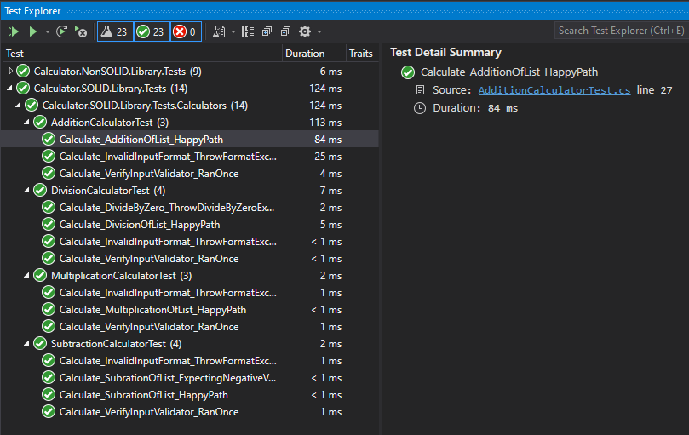
What is Unit Testing?
Unit testing scopes down the program code logic into the smaller piece for able to Test.
This is usually function-level and ensures that the function returns the value one expects.
By applying a unit testing framework, unit tests become a separate entity that can then run automated tests on the program as it is being built.
In simplest said, code with test cases.
Unit Test

Slide 17
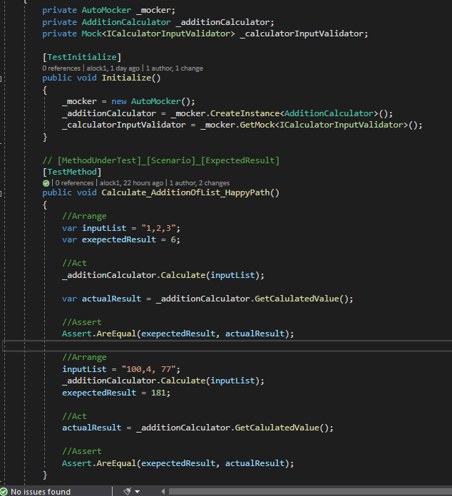
Explanation of 3 A’s [Arrange, Act, Assert]
A simple unit test using the Arrange, Act, Assert [3 A’] methodology testing on our math library for correctly Sum all lists of the input number. The same goes for Subtraction, Multiplication & Division

Slide 18
The Benefits and Purpose of Unit Testing
The hardest benefit of unit testing is understanding
Super important was the ability to retest changed code on the fly. The first line of defense & is simple.
How do you ensure your code change won’t break another part of the code?
Is Your code Testable?
How do you ensure most all the business logic is work expected?
How do you ensure most of the scenarios are covered?

Slide 19
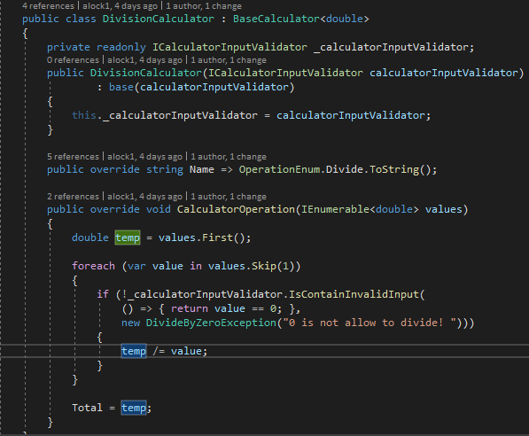
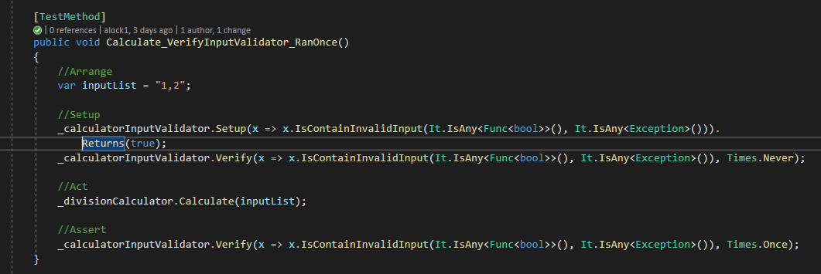
SOLID + TDD Walkthrough
Unit Testing Frameworks for DotNet
The Microsoft Unit Testing Framework is the out-of-the-box unit testing solution
from Microsoft and included with Visual Studio.
Mocking Technique on Dependency Injection. For example, set the ICalculatorInputValidator.
Verify the Validator has been ran through how many times.

Slide 20
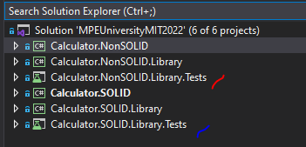
TDD without SOLID vs TDD with SOLID sample
Code Walkthrough

Slide 21
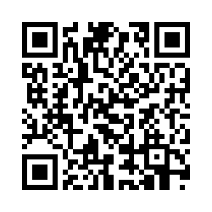
Share Your Input
We need YOUR feedback to improve for next time!
Please tell us how we did:
goto/MPEUsurvey
MPE Global University Survey

